Slide 1
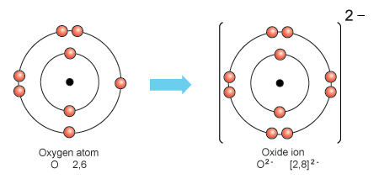
Daily Review
CFU 1
Do negative ions form when electrons are lost or gained?
Negative Ions
Formed when atoms gain electrons to fill the valence shell to the nearest noble gas configuration.
The number of electrons the atom gains becomes the negative charge on the ion.
Oxide ions form when an oxygen atom gains 2 electrons.
Fluoride ions form when a fluorine atom gains 1 electron.
CFU 2
Chlorine is in the same group as fluorine. How many electrons would it gain?
CFU 3
Write the symbol for a chloride ion.
O²⁻
F⁻

Slide 2
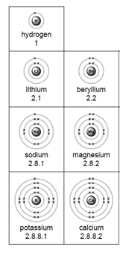
Daily Review
CFU 1
Strontium is in group 2. What is the valency of a strontium ion?
Using the Periodic Table to Predict Valencies
Elements in group 1 always lose their valence electron, forming ions with a valency of 1+ H⁺ Li⁺ Na⁺ K⁺
Elements in group 2 always lose 2 valence electrons, forming ions with a valency of 2+ Be²⁺ Mg²⁺ Ca²⁺
Group 1
CFU 2
Rubidium is underneath potassium on the Periodic Table. What is its valency?
Group 2

Slide 3
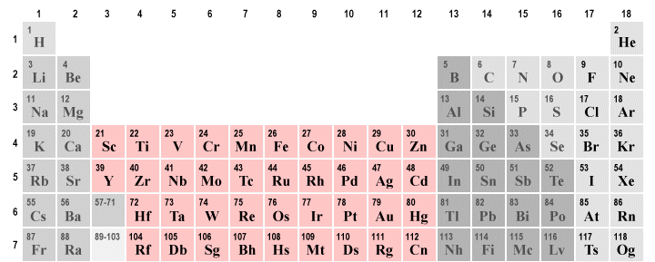
Daily Review
CFU 1
Copper can have a valency of +1 or +2. Write the symbol for the two ions.
Elements with Multiple Valencies
Some transition metals can form ions with different valencies.
Lead can form ions with a valency of 2+ or 4+ Pb²⁺ or Pb⁴⁺
The valency is written as roman numerals in brackets after the name of the element Lead (II) or Lead (IV)
CFU 2
Copper can have a valency of +1 or +2. Write the name for the two ions.

Slide 4
Writing Ionic Formulae Year 9 Chemistry

Slide 5
Learning Objectives
CFU
What are we going to learn?
Write ionic formulae from ions
Activate Prior Knowledge
Some compounds are made from a metal and a non-metal. Sodium chloride (table salt) contains one atom of sodium and one of chlorine. Its chemical formula is NaCl.
For each of the compounds listed below, underline the metal atom and put a circle around the non-metal.
ZnO MgCl₂ FeO AlBr₃

Slide 6
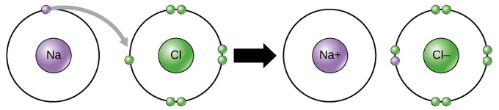
Concept Development
CFU 1
What happens to the metal’s electrons?
Ionic Compounds
Ionic compounds form when a metal with a nearly empty outer shell reacts with a non-metal with a nearly full outer shell.
The metal loses the electrons from the valance shell and donates them to the non-metal, filling its valence shell.
The oppositely charged ions attract, forming an ionic bond.
CFU 2
How does an ionic bond form?

Slide 7
Concept Development
CFU 1
What happens to the charges in an ionic compound?
Rules for Writing Ionic Formulae
The positive ion is written first.
The negative ion is written second (non-metal or group of non-metals).
The total number of each ion is adjusted so that the total positive charge equals the total negative charge.
Subscripts are used to indicate the number of each ion present.
CFU 2
How are subscripts used?
For example Calcium bromide
Ca²⁺ Br⁻
1 Ca²⁺ for 2 Br⁻
CaBr₂

Slide 8
Skill Development/Guided Practice
Writing Ionic Formulae
Write the formula for each ion, including the valency Determine how many of each ion is needed to make the overall charge neutral Write the formula with the number of each ion needed at the bottom right of the symbol
Write the formula for aluminium bromide
1 Al³⁺ Br⁻
1 Al³⁺ balances 3 Br⁻
Correct formula: AlBr₃

Slide 9
Skill Development/Guided Practice
Writing Ionic Formulae
Write the formula for each ion, including the valency Determine how many of each ion is needed to make the overall charge neutral Write the formula with the number of each ion needed at the bottom right of the symbol
Write the formula for sodium oxide.
1 Na⁺ O⁻²
2 Na⁺ balances 1 O⁻²
Correct formula: Na₂O

Slide 10
Skill Development/Guided Practice
Writing Ionic Formulae
Write the formula for each ion, including the valency Determine how many of each ion is needed to make the overall charge neutral Write the formula with the number of each ion needed at the bottom right of the symbol
Write the formula for sodium chloride.
1 Na⁺ Cℓ⁻
1 Na⁺ balances 1 Cℓ⁻
Correct formula: NaCℓ

Slide 11
Skill Development/Guided Practice
Writing Ionic Formulae
Write the formula for each ion, including the valency Determine how many of each ion is needed to make the overall charge neutral Write the formula with the number of each ion needed at the bottom right of the symbol
Write the formula for magnesium fluoride.
1 Mg²⁺ F⁻
1 Mg²⁺ balances 2 F⁻
Correct formula: MgF₂

Slide 12
Skill Development/Guided Practice
Writing Ionic Formulae
Write the formula for each ion, including the valency Determine how many of each ion is needed to make the overall charge neutral Write the formula with the number of each ion needed at the bottom right of the symbol
Write the formula for potassium nitride.
1 K⁺ N⁻³
3 K⁺ balances 1 N⁻³
Correct formula: K₃N

Slide 13
Skill Development/Guided Practice
Writing Ionic Formulae
Write the formula for each ion, including the valency Determine how many of each ion is needed to make the overall charge neutral Write the formula with the number of each ion needed at the bottom right of the symbol
Write the formula for magnesium oxide.
1 Mg⁺² O⁻²
1 Mg⁺² balances 1 O⁻²
Correct formula: MgO

Slide 14
Skill Development/Guided Practice
Writing Ionic Formulae
Write the formula for each ion, including the valency Determine how many of each ion is needed to make the overall charge neutral Write the formula with the number of each ion needed at the bottom right of the symbol
Write the formula for aluminium oxide.
1 Al⁺³ O⁻²
2 Al⁺³ balances 3 O⁻³
Correct formula: Al₂O₃

Slide 15
Relevance
Knowing how to write ionic formulae will help you represent chemical reactions as balanced formula equations.

Slide 16
Skill Closure
Which part of an ionic formula is written first? Which part is written second?
Skill Closure
What needs to be done with the valences / charges when writing an ionic formula?
Writing Ionic Formulae
Write the formula for each ion, including the valency Determine how many of each ion is needed to make the overall charge neutral Write the formula with the number of each ion needed at the bottom right of the symbol
Skill Closure
Write the formula for magnesium nitride.

Slide 17
Independent Practice
Complete the “Ionic Formula” worksheet on a paper copy.

